Slide 1
Duolingo Mock Test System
An AI-Powered Platform for English Test Preparation
Donakonda. Poleswari (N190028)

Slide 2
Table of Contents
Abstract
Introduction
Related/Existing Works
Proposed Method
Technical Details
Workflow & Pseudo code
Initial Results
Conclusion
Future Work
References

Slide 3
Abstract
Problem Statement: Many test-takers struggle to perform well in the Duolingo English Test due to limited practice and feedback mechanisms.
Objective: Develop an AI-based system to simulate the Duolingo test environment and offer intelligent feedback.
Features:
Timed practice for reading, writing, listening, and speaking sections.
AI-generated questions with instant feedback and scoring.
Technologies Used: Flask, Python, React Js, Azure Speech Services, OpenAI.
Outcome: A comprehensive system that boosts user confidence and readiness.

Slide 4
Introduction
Duolingo English Test is widely accepted but often challenging due to its adaptive nature.
Test-takers lack structured mock platforms with smart feedback.
Our system mimics real test scenarios and adapts dynamically.
Focused on improving user’s proficiency and test strategies.

Slide 5
Related/Existing Works
Existing Tools:
Duolingo Practice App (offers basic preparation features).
YouTube practice videos (lack interactivity and real-time feedback).
Limitations:
Lack of adaptive, test-like simulation with scoring logic.
No personalized evaluation, real-time analytics, or structured progress tracking.
Advancement: Our system bridges these gaps by offering AI-driven mock testing, automated scoring, real-time feedback, and detailed performance analytics tailored to the Duolingo English Test format.

Slide 6

Related/Existing Works

Slide 7
Proposed Method
System Overview:
AI-driven test generation aligned with DET format.
Timed tests and instant scoring.
Grammar, fluency, and pronunciation evaluation.
Modules:
User Authentication and Profile Management.
Skill-Specific Practice: Reading, Listening, Writing, Speaking.
Real-Time Response Capture and Evaluation.
Dashboard with feedback and analytics.
Key Features:
Adaptive difficulty.
Detailed score reports.
Personalized improvement suggestions.

Slide 8
Technical Details
Backend: Flask (Python).
Frontend: React Js, Tailwind CSS
AI & APIs:
Azure Speech Services for voice analysis.
OpenAI & Claude for question generation and feedback generation.
Database: MySQL for storing responses, scores, feedbacks, and user details.
Security:
Secure login with password hashing.
CSRF protection and session validation.
Deployment: Hosted on AWS for performance and scale.
System Hardware: Intel Core i5, 8GB RAM, 500 GB storage, Webcam, Microphone Access

Slide 9
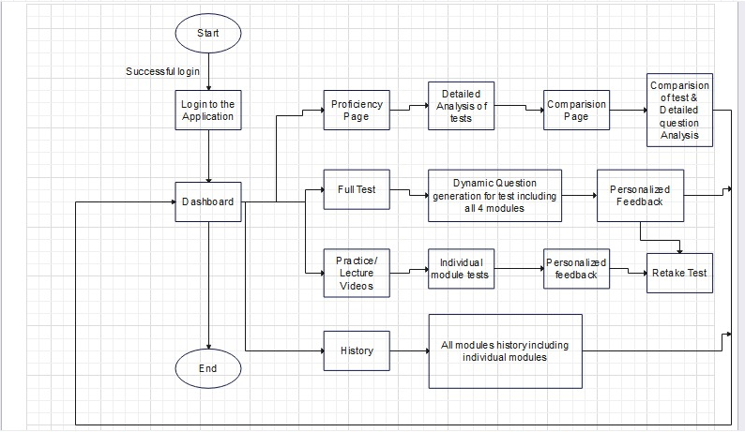
Work Flow

Slide 10
Pseudo Code/Algorithm
Workflow Overview:
User logs in and selects test module.
Randomly generated AI questions.
User attempts the questions; responses recorded.
System analyzes responses using AI models.
Feedback and scores shown on the dashboard.
Proficiency metrics and navigation to comparison pages.
Detailed analysis of correct/incorrect questions.

Slide 11
ALGORITHM
def duolingo_mock_test():
user = authenticate_user(credentials)
if user:
setup_environment(mic_check=True, speaker_check=True)
# Full Test Flow - Adaptive
modules = ['Reading', 'Listening', 'Speaking', 'Writing']
results = {}
for module in modules:
questions = generate_adaptive_questions(module, user_profile)
for question in questions:
if module == 'Speaking':

Slide 12
ALGORITHM
response = record_audio_response()
elif module == 'Writing':
response = record_written_response()
else:
response = capture_mcq_or_input()
feedback = evaluate_response(module, response)
store_result(user.id, module, response, feedback)
results[module] = summarize_module_score(module, user.id)
# After test completion
generate_performance_report(user.id, results)
show_dashboard(user.id)

Slide 13
Initial Results
Functional modules for reading, listening, speaking, and writing tests completed.
Positive feedback from beta users on test experience and feedback accuracy.
Screenshots:
Test landing page.
Speaking module with timer and recording.
Result dashboard with score breakdown.

Slide 14

LOGIN PAGE

Slide 15
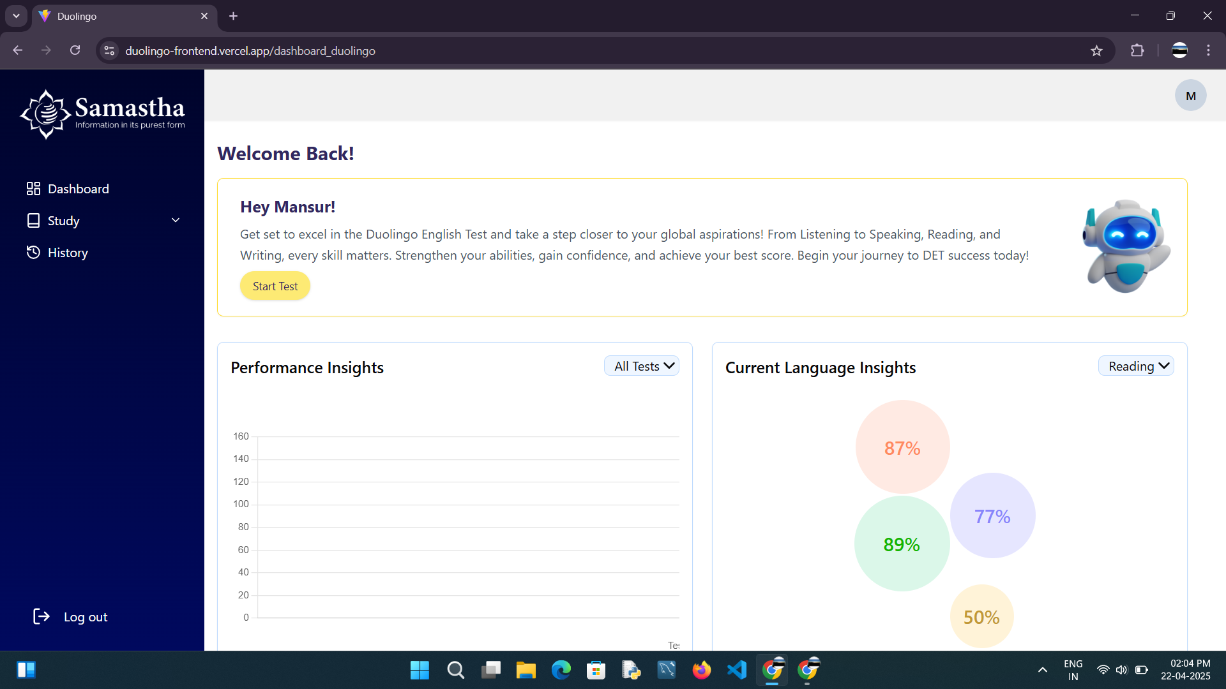
DASHBOARD

Slide 16
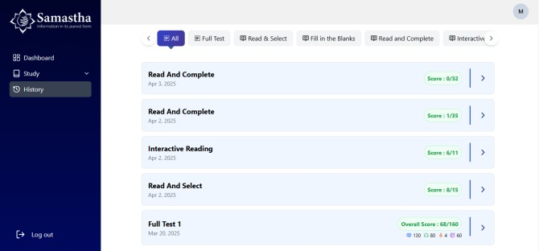
HISTORY

Slide 17
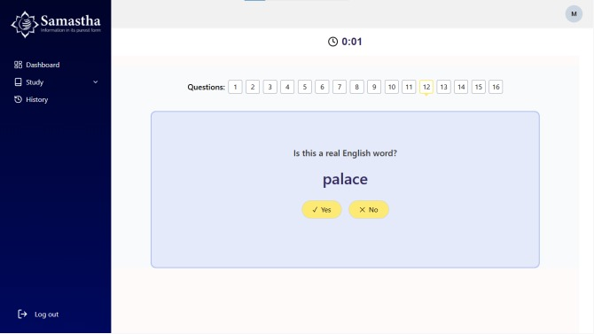
FULL TEST

Slide 18
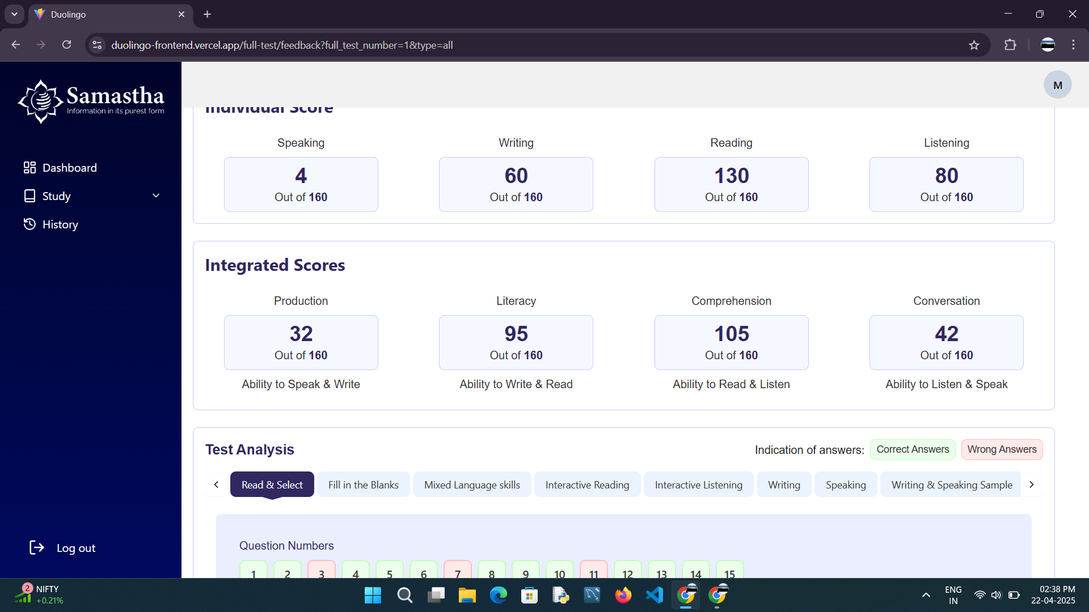
FEEDBACK

Slide 19
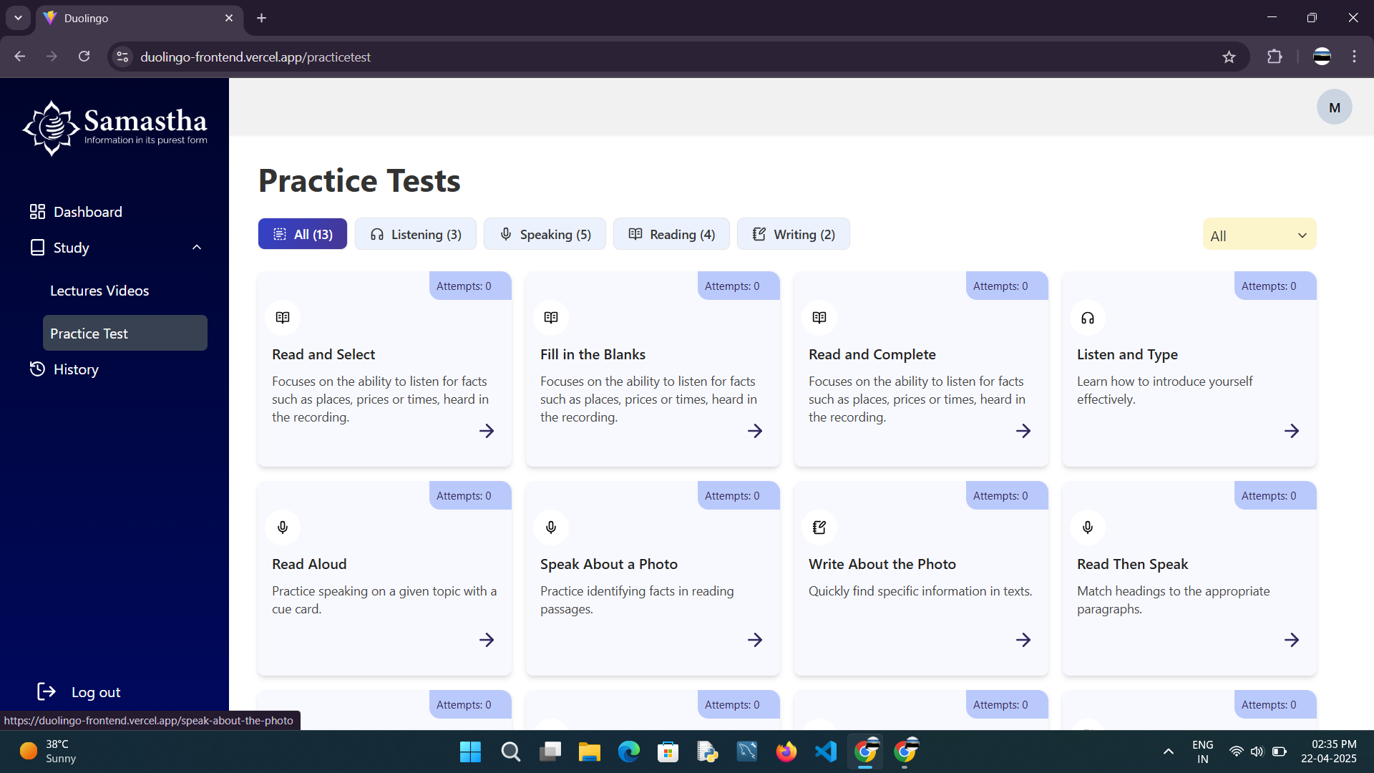
PRACTICE

Slide 20
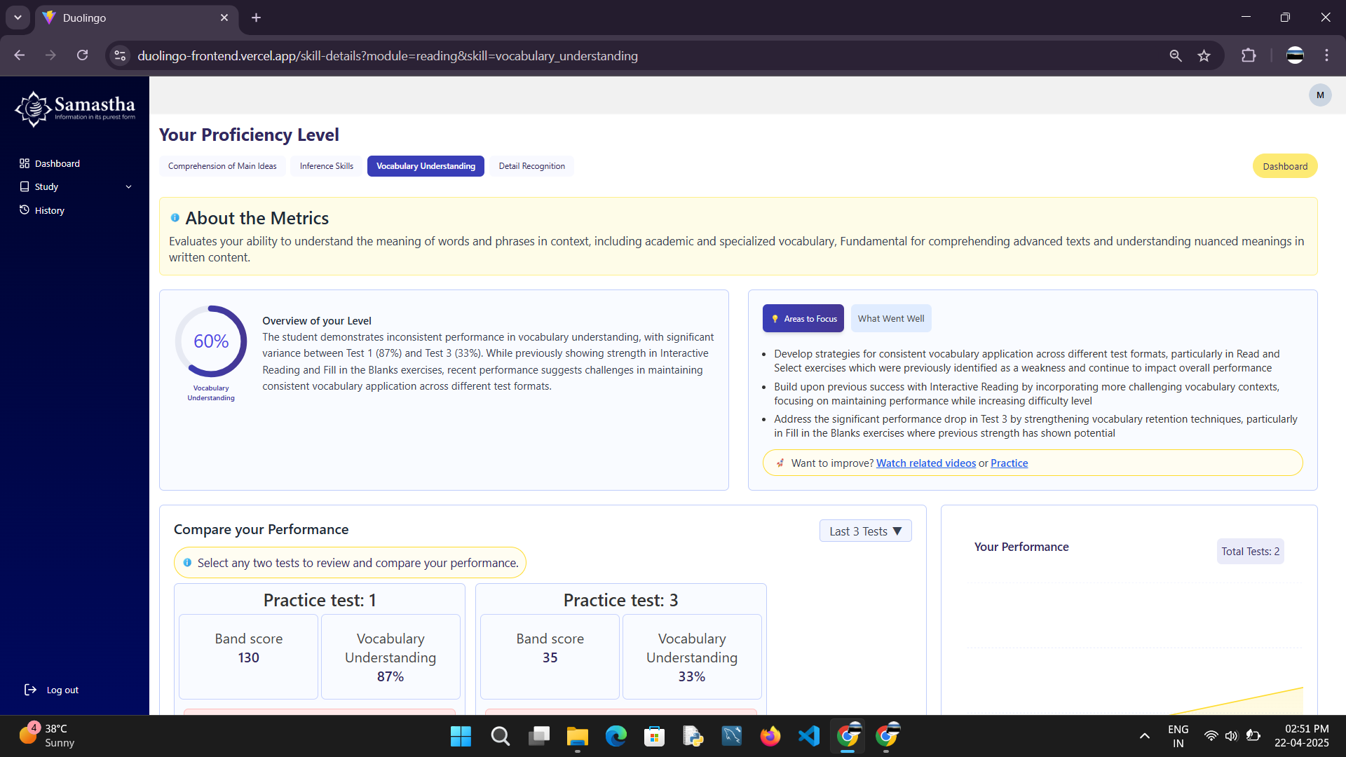
PROFICIENCY

Slide 21
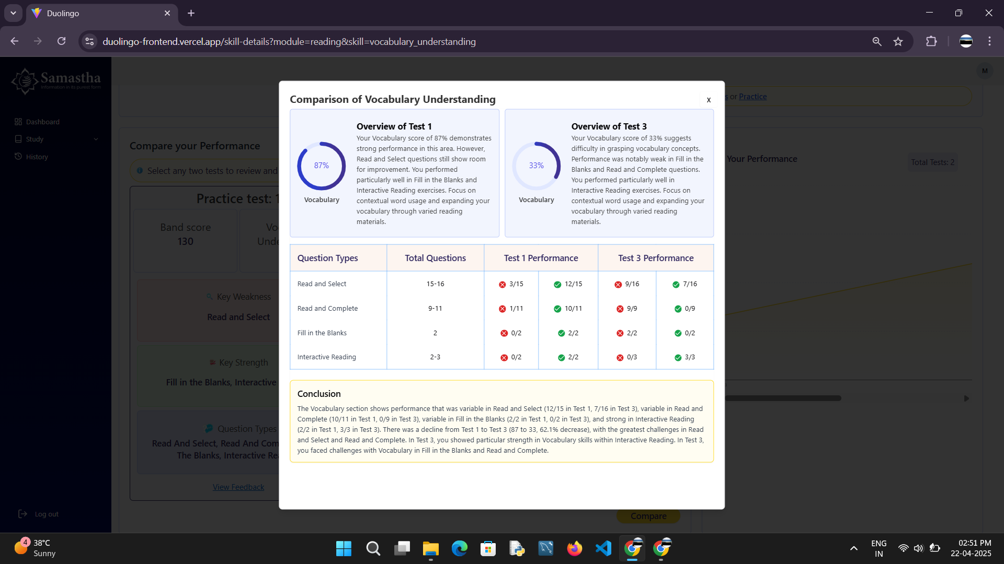
COMPARISION

Slide 22
Conclusion
A smart, user-friendly platform for DET preparation.
AI integration enables accurate scoring and actionable feedback.
The system empowers users with confidence and better preparation strategies.

Slide 23
Future Scope
Implement support for offline testing.
Add peer review and community scoring features.
Visual feedback for facial expressions and eye contact in speaking tests.
Integration with learning platforms for personalized study plans.
Expand to support TOEFL, PTE, and other English proficiency tests.

Slide 24

Future Scope

Slide 25
References
[1] Mehta, P., Kumar, A., and Bhattacharjee, S., "Fire and gun violence based anomaly detection system using deep neural networks," in Proc. Int. Conf. on Electronics and Sustainable Communication Systems (ICESC), IEEE, pp. 199-204, Jul. 2020.
[2] Tiwari, R.K., and Verma, G.K., ”A computer vision based framework for visual gun detection using Harris interest point detector,” Procedia Computer Science, vol. 54, pp.703-712, 2015.

Slide 26
References
[3] Krizhevsky, A., Sutskever, I., and Hinton, G.E., ”ImageNet classification with deep convolutional neural networks,” Advances in Neural Information Processing Systems, vol. 25,pp. 1097-1105, 2012.
[4] Duolingo English Test, ”Official Test Guidelines,” Duolingo English Test Documentation,2023. [Online]. Available: https://englishtest.duolingo.com
[5] Brown, T., Mann, B., Ryder, N., et al., ”Language models for adaptive testing,” Journal of Educational Technology, vol. 45, no. 2, pp. 112-130, 2020.
[6] Microsoft Azure, ”Speech to Text API Documentation,” Microsoft Developer Network, 2023. [Online]. Available: https://docs.microsoft.com/azure/cognitive-services.

Slide 27
THANK YOU

